Slide 1
IMPROVEMENT ON POST-PROCESSING FOR OCR DATA
Improvement based on D3 and Statistical Learning for OCR Text Correction
Group members: Yang Cai, Yunsheng Ma, Jiaxi Wu, Huiming Xie, Jiaqian Yu

Slide 2
SUMMARY
Error Detection
Error Correction
Evaluation

Slide 3
ERROR DETECTION
Based on
Paper D3
Statistical Learning for OCR Text Correction

Slide 4
COMPARISON OF CLASSIFICATION MODELS
 | Random forest | SVM | Xgboost | GBM | Logistics Regression
Time | <5 mins | >30 mins | <5mins | <10 mins | <5mins
Precision | 89% | 82% | 88% | 88% | 82%
Recall | 90% | 86% | 84% | 85% | 80%
Additional benefit | Feature selection Deal with interaction term Robust | Deal with interaction term Do not have feature selections Inefficient to train | Features selection Deal with interaction term

Slide 5
ERROR DETECTION
Random Forest (Improved)
Handles high dimensional spaces and large training samples well
Train faster than SVM (SVM takes 30 min, RF less than 10 min)
Generate a robust estimate
SVM (Original)
Involve expanding feature spaces: adding interaction terms
Do not have feature selections
Inefficient to train
Model Comparison
SVM
Random Forest
Xgboost
GBM
Logistics Regression

Slide 6
ERROR DETECTION
1
the length l of the input string
the number v of vowels and the number c of consonants in the string, as well as the quotients v/l, c/l, v/c (for c = 0)
the number of special (non-alphanumerical) symbols s and the quotient s/l
the number of digits d and the quotient d/l
the number of lowercase letters low, the number of uppercase letters upp, and the quotients low/l, upp/l
for strings containing a sequence of at least three consecutive occurrences of the same symbol, we use the quotient of the length of the maximal sequence of identical letters divided by l. For other strings the feature receives value 0
We calculate the number of all alpha-numerical symbols lα occurring in the string, and the number k of other symbols s. For k > lα the value Feature 7 is 1,for other strings the value is 0
2
3
4
5
Based on
Paper D3 Sec.5
Statistical Learning for OCR Text Correction Sec. 4.1
6
7

Slide 7
ERROR DETECTION
8
If the input string contains a subsequence of ≥ 6 directly consecutive consonants, Feature 8 received value 1, otherwise value 0
We delete the first and last symbol of the input string. If the remaining infix contained two or more non alpha-numerical symbols, Feature 9 receives value 1, and otherwise value 0
bigram sum(frequency of the ith bigram in the list Lb/10000)/number of bigrams in input string
We computed the number of occurrences i of the most frequent symbol of the input string of length l. For i ≥ 3 we used i/l as a feature value, for i ≤ 2 the value was set to 0
Let l1 denote the number of occurrences of alphabetical symbols in the input string, let l2 = l − l1 denote the number of occurrences of all other types of symbols. We used l2/l1 as a feature.
Levenshtein distance
9
10
Based on
Paper D3 Sec.5
Statistical Learning for OCR Text Correction Sec. 4.1
11
12
13

Slide 8
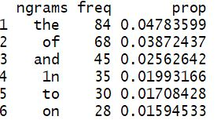
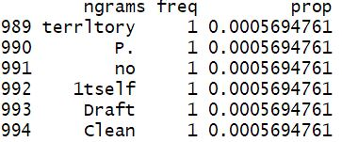
ERROR DETECTION
Consider a common word is less likely to be an error word, the 1-gram frequency of a word should be greater than a frequency threshold. The frequency threshold varies with different word length.
14
Based on
Paper D3 Sec.5
Statistical Learning for OCR Text Correction Sec. 4.1
Most frequent words
Least frequent words

Slide 9
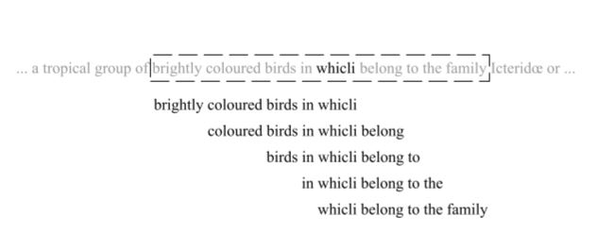
ERROR DETECTION
A word is likely to be correct if this word with its context occurs in other places. We use a sliding window to construct n-gram contexts for a word. The frequency of one of the context in the n-gram corpus should be greater than a frequency threshold.
15
Based on
Paper D3 Sec.5
Statistical Learning for OCR Text Correction Sec. 4.1
Example of sliding window of size five

Slide 10
ERROR CORRECTION
Based on
Statistical Learning for OCR Text Correction

Slide 11
ERROR CORRECTION
From Paper Statistical Learning for OCR Text Correction Sec 4.2-4.4
Step 1. Candidate Search
Step 2. Compute Feature Scores
Step 3.Train Model
Select a candidate for each error according to Levenshtein distance
Step 4. Candidate Ranking & Correct
Levenshtein edit distance
String similarity
Language popularity
Lexicon existence
Exact-context popularity
Use scores as features
Label 1 if the candidate is the same as ground truth, label 0 otherwise.
Rank test set error candidates
Choose the one with highest score for correction

Slide 12

ERROR CORRECTION
Step 1. Candidate Search
Candidate Set for a detected error we
Minimum Levenshtein distance
Distance threshold
Based on
Statistical Learning for OCR Text Correction
Sec 4.2

Slide 13
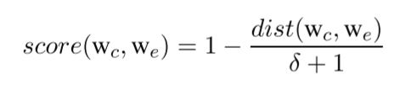
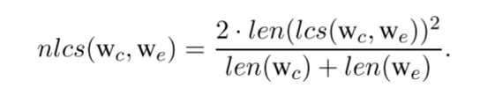
ERROR CORRECTION
Step 2. Compute Feature Scores
1
Levenshtein edit distance
Based on
Statistical Learning for OCR Text Correction
Sec 4.3
2
String similarity

Slide 14
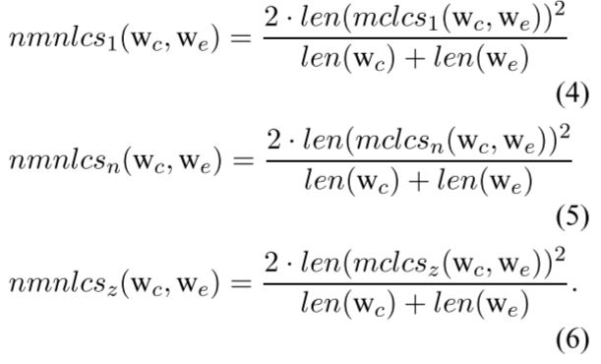
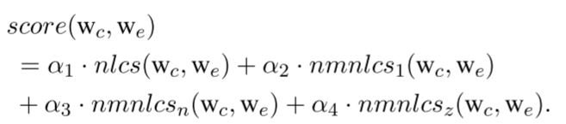
ERROR CORRECTION
Step 2. Compute Feature Scores
2
String similarity (contd.)
Based on
Statistical Learning for OCR Text Correction
Sec 4.3

Slide 15
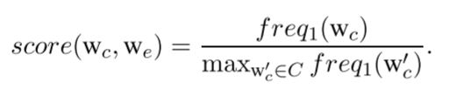
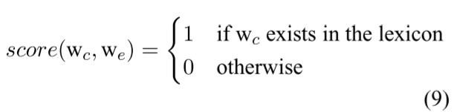
ERROR CORRECTION
Step 2. Compute Feature Scores
3
Language popularity
Based on
Statistical Learning for OCR Text Correction
Sec 4.3
4
Lexicon existence

Slide 16
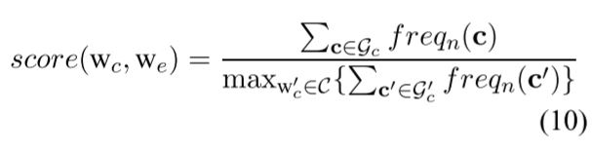
ERROR CORRECTION
Step 2. Compute Feature Scores
5
Context popularity
N gram frequency
Based on
Statistical Learning for OCR Text Correction
Sec 4.3

Slide 17
ERROR CORRECTION
Step 3. Train model
1
Features
Use the scores computed in step 2 as features
Labels
Label 1 : if the candidate is the same as ground truth
Label 0: if the candidate is different from ground truth
2
Based on
Statistical Learning for OCR Text Correction
3
Model
Random Forest, XGBOOST, adaboost
4
Cross Validation (5-fold)

Slide 18
ERROR CORRECTION
Step 4. Candidate Ranking & Correction
Rank test set candidates according to predicted scores
Choose the one with highest score for correction
Based on
Statistical Learning for OCR Text Correction Sec 4.4

Slide 19
EVALUATION

Slide 20
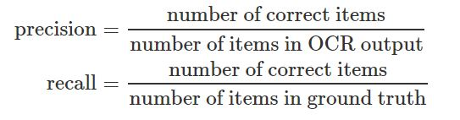
EVALUATION
 | Tesseract (D3 detection) | Tesseract (Improved detection)
word_wise_recall | 0.82 | 0.89
word_wise_precision | 0.86 | 0.90
Error Detection

Slide 21
EVALUATION
 | Tesseract (C4 correction) | Tesseract (improved correction)
word_wise_recall | 0.71 | 0.76
word_wise_precision | 0.70 | 0.75
character_wise_recall | 0.88 | 0.90
character_wise_precision | 0.89 | 0.91
Error Correction

Slide 22
THANK YOU

